Slide 1
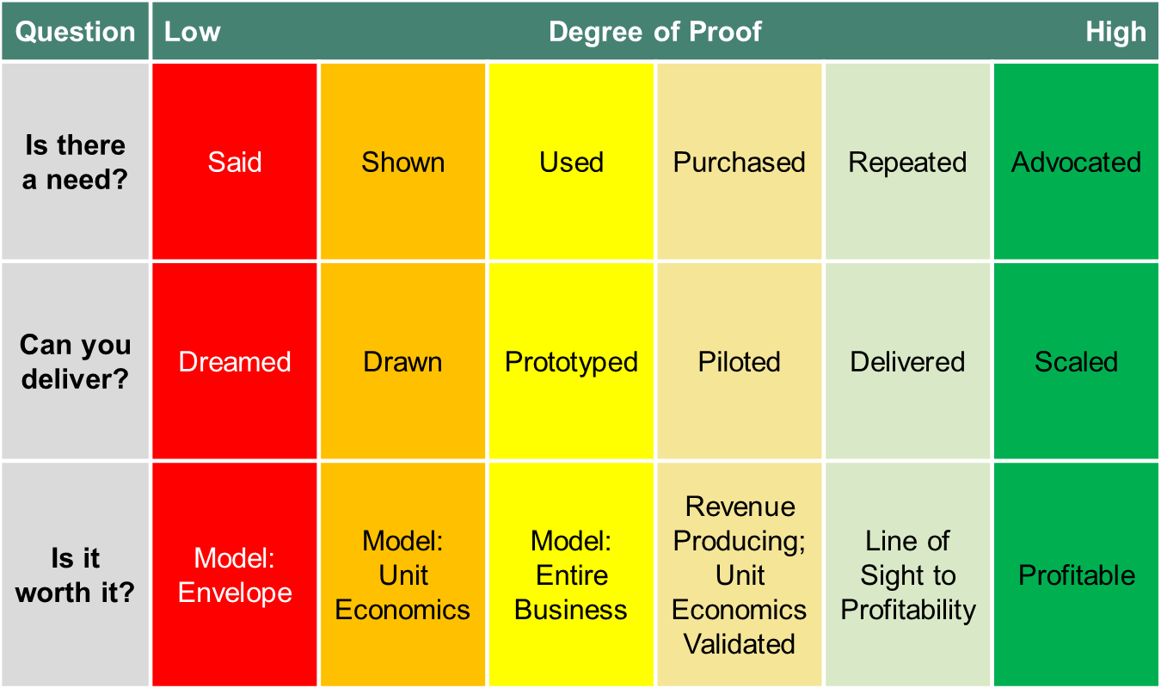
Understanding the First Mile Certainty Table
The First Mile Certainty Table is a way to develop a better grounding of true levels of confidence in an idea. Building off three key questions (Is there a need? Can you deliver? Is it worth it?), it provides a quick way to gauge confidence in each area.
Run experiments to increase certainty if an area of your idea falls on the left side of the table (your knowledge is low)
The First Mile Certainty Table helps guide activities to increase certainty in an idea:
As a team, evaluate where the idea is for each key question
The further to the left of the table, the greater the uncertainty
For each area where your knowledge is low, run a quick, low-cost experiment that will move the idea to the right
Revisit the chart on a quarterly basis
The simplicity of the table makes it a great tool for team discussion. Print it out and gain consensus as to today’s level of knowledge.

Slide 2
First Mile Certainty Table
Focus in on the areas of highest uncertainty using the table below:
Question | Low |  | Degree of Proof |  | High
Is there a need? | Said | Shown | Used | Purchased | Repeated | Advocated
Can you deliver? | Dreamed | Drawn | Prototyped | Piloted | Delivered | Scaled
Is it worth it? | Model: Envelope | Model: Unit Economics | Model: Entire Business | Revenue Producing; Unit Economics Validated | Line of Sight to Profitability | Profitable

