Slide 1
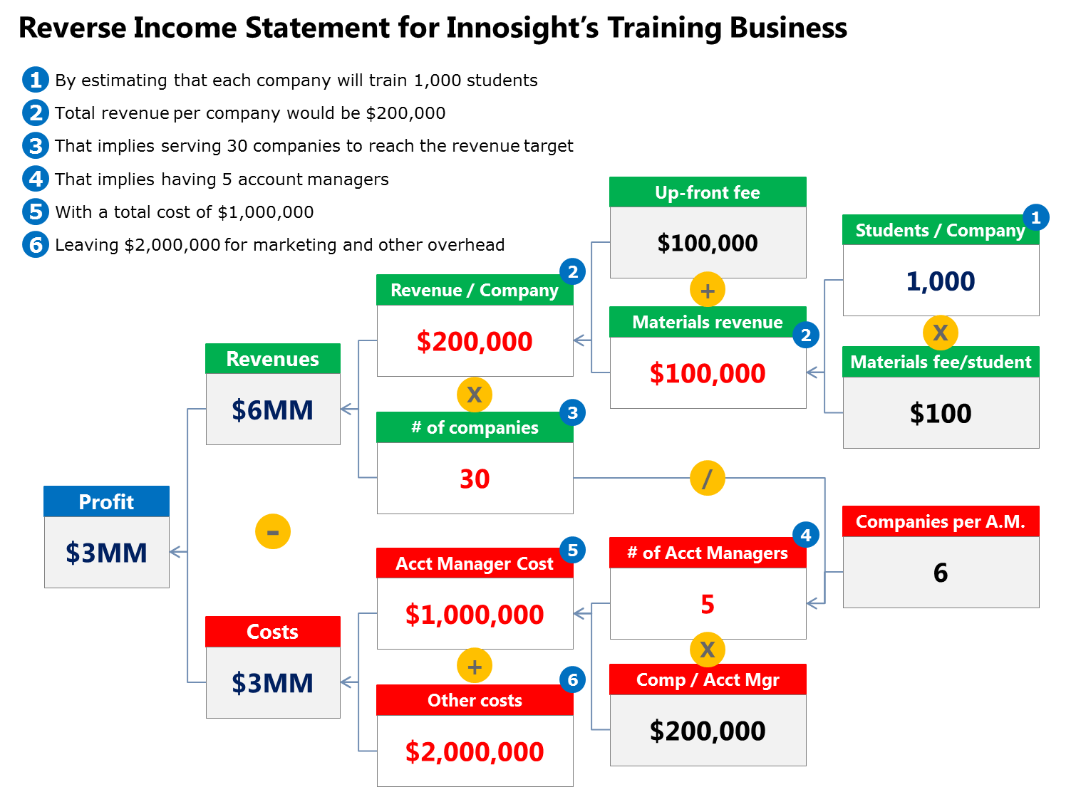
Understanding the Reverse Income Statement
Rita McGrath and Ian MacMillan’s 1995 classic ‘Discovery-Driven Planning’ article advanced the notion that when assumptions are high and knowledge is low, innovators should follow a different approach to planning. A key component is what they dubbed a reverse income statement.
A reverse income statement looks like a decision tree:
On the left side is a single box with the answer – the desired profit that a business should produce, or its revenue
The next column splits that answer into no more than 3 variables; the next column splits each of those boxes into no more than 3 variables, and so on
Seeing the results of simple logic can be useful as it helps to visualize the business and highlight uncertainties.
Shaded (and numbered) boxes above are assertions or assumptions (also detailed in top left). This tree helped raise critical questions about the business.

Slide 2
Reverse Income Statement
Assumptions:
Assumption 1
Assumption 2
Assumption 3
Annual Revenue/customer
Component 1: $X
Component 2: $X
Cost driver
Total: $X
Profit margins:
Component 1: X%
Component 2: X%
Overall: X%
Revenues per year
$X
Component 1: $X
Component 2: $X
Customers
Cost driver
X
$X
Total: $XB
Profit
Cost driver
Component 1: $X
Component 2: $X
Annual costs/customer
$X
Costs per year
Component 1: $X
Component 2: $X
Total: $XM
Component 1: $X
Component 2: $X
Cost driver
$X
Total: $XM
Customers
Cost driver
X
$X

