Slide 1
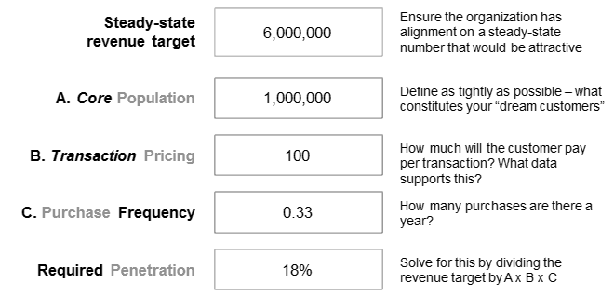
Understanding the 4P Model
This technique can be conducted as a quick five-minute exercise, yet provides very solid learning. It serves as an efficient way to sanity check an idea and get rich insight into the viability of a particular business model.
Calculating the idea’s 4Ps:
Start with the desired answer you determined (e.g. path to $6M in revenue)
With the answer, determine the population of potential customers. Define it as narrowly as possible
Assert the price of the offering
Assess the purchase frequency. Is it a one-time purchase? A consumable good that people purchase a few times a year? A rental? A daily purchase?
Finally, calculate the required penetration to achieve your target
Use the simple, five-minute, 4P (target Population, planning Pricing, expected Purchase frequency, and required Penetration) calculation to see quickly if your idea meets the minimum threshold and is worth pursuing.

Slide 2
The 4P Calculation
CORE MARKET
Ensure the organization has alignment on a steady-state number that would be attractive
Steady-state revenue target
A. Core Population
Define as tightly as possible – what constitutes your “dream customers”
B. Transaction Pricing
How much will the customer pay per transaction? What data supports this?
C. Purchase Frequency
How many purchases are there a year?
Required Penetration
Solve for this by dividing the revenue target by A x B x C
OPTION VALUE
What other markets open up as a result of following this strategy?

